Slide 1


EDA on Netflix Movies & TV Shows

Slide 2

Project Overview
This project explores the Netflix dataset, which contains details about movies and TV shows available on the platform.
The objective is to perform exploratory data analysis (EDA) to uncover insights about content trends, genres, ratings, and country-wise availability.
Tools used: Python, Pandas, NumPy, Matplotlib, Seaborn

Slide 3

Dataset Information
Data source: netflix_titles.csv dataset from Kaggle.
Entries: 8,807 rows, 12 columns.
Key columns:
Type (Movie or TV Show)
Title
Director and Cast
Country
Date Added
Release Year
Rating
Duration
Listed In (Genre)
Missing Data Handling: Missing values filled for director, cast, country, and date_added.

Slide 4





Visualisation Techniques
In EDA, we analyze patterns using visualization techniques:
Pie Chart
Bar Plot
Line Plot
Distribution of Movies vs TV Shows
Top 10 Countries with Most Titles
Number of Releases per Year
Histogram
Count Plot
Movie Duration Distribution
Ratings and Genre Analysis

Slide 5
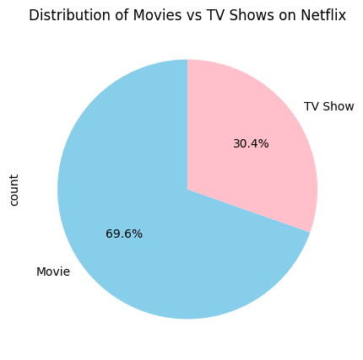
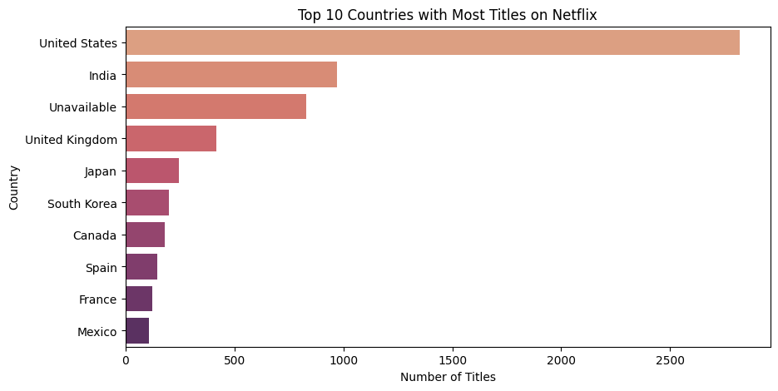
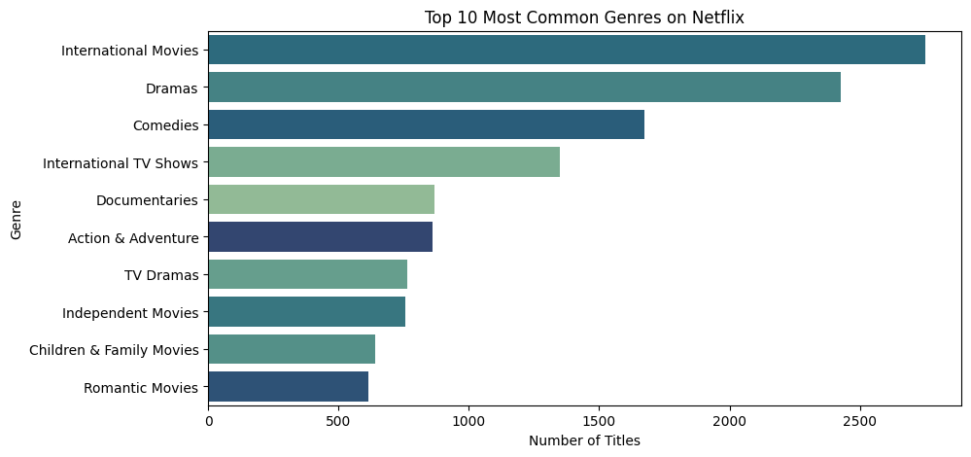
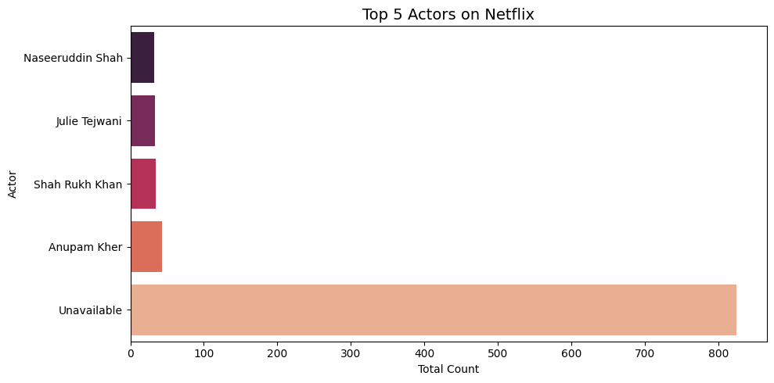
Visualisation

Slide 6
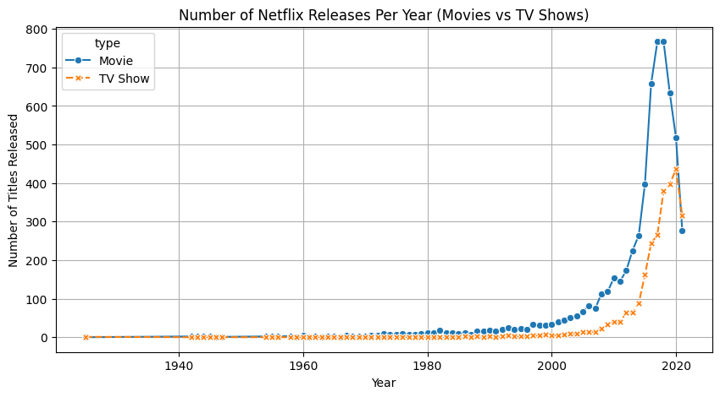
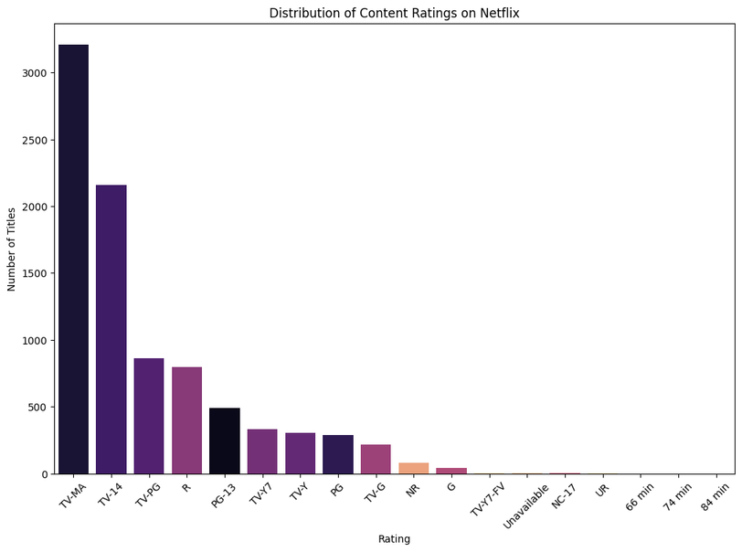
Key Insights
Movies make up a larger share than TV Shows on Netflix.
The United States and India produce the most content.
Most Netflix releases are from 2015–2020, showing rapid growth.
The most common genres include Dramas, Comedies, and Documentaries.
Most movies have a duration between 80–120 minutes.
Popular TV shows often have 1–3 seasons.

Slide 7

Conclusion and Observations
Netflix’s content library is highly diverse, both in terms of genre and geographic origin, reflecting its global audience and creative partnerships.
The majority of titles are Movies, suggesting that Netflix still prioritizes film releases over series, even though its original shows are globally popular.
TV-MA rated content dominates the platform, indicating a strong focus on mature storytelling and realistic narratives.
There’s a notable growth in content after 2015, aligning with Netflix’s international expansion and original content boom.
The platform showcases a balance between entertainment and creativity, consistently evolving to meet audience preferences across different cultures and age groups.
Overall, the analysis highlights how Netflix has transformed into a global digital entertainment powerhouse, driven by data-backed decisions, diverse content strategies, and audience insights.
Movies
TV Shows

